Slide 1
Welcome to Chemistry!
Lab One

Slide 2
Lab safety
Locate the fire extinguisher and the safety shower.
Always ask before touching any chemical.
Keep hair back when using the Bunsen Burner.
Report any spills or glass breakage immediately!
Wear gloves and safety glasses when using chemicals.
No horseplay, eating, or drinking in the lab!
Be careful when moving around the lab.
Do not squirt each other with the wash bottles.

Slide 3
Glassware
Flask – used for stirring solutions
Volumetric flask – used to make standardized solutions
Beaker – used to transfer liquids from the stock bottle to another piece of glassware
Graduated cylinder – used for measuring a specific amount of a liquid
Boiling flask – used for boiling a liquid for distillation
Pipette – used for measuring small amounts of a liquid
Condenser or condensation tube – used for collecting vapor and returning it to a liquid
Buret – used for titrations to measure the amount of a liquid needed to make a neutral solution.

Slide 4
Measuring instruments
Triple beam balance – used for measuring the mass in grams of a substance
Analytical balance – digital scale that can measure in grams or pounds
Meter stick – used for measuring distance in millimeters, centimeters, decimeters, or meters.
Graduated cylinder / pipette – used for measuring amounts of a liquid in milliliters, centiliters, deciliters, or liters.
Buret – used for measuring amounts of a liquid when performing titrations

Slide 5
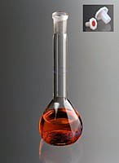
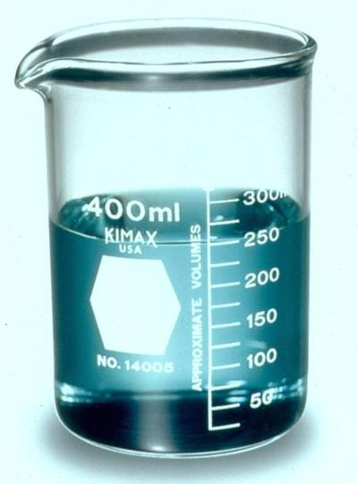
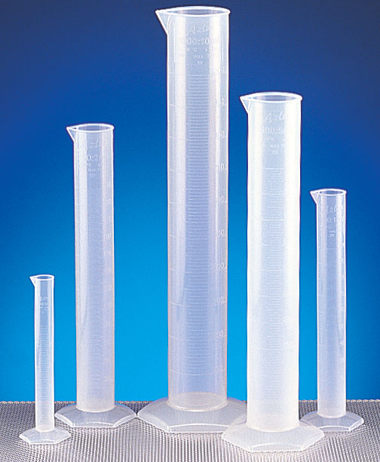
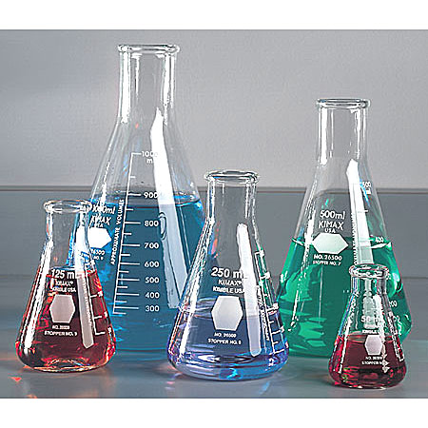
Draw some GLASSWARE!
Beaker
Erlenmeyer Flasks
Graduated Cylinders
Volumetric Flask

